Slide 1
Stopwatch project
MADE BY:-
احمد زكريا عبد العال
احمد محمد محمود
اسلام محمود توفيق
احمد فتحي عواد
اشرف محمد ابراهيم
رمزي احمد رمزي
DR\ Tarek el-Kammar
ENG\ Moatasem Kotb

Slide 2
The equipments used:-
Two 7 seg com cathode
IC 4033
Resistors(150-33k-56k-100k)ohm
Wires
10UF cap
DC source 5V
TIMER 555 IC
TWO PUSH BOTTONS
LED

Slide 3
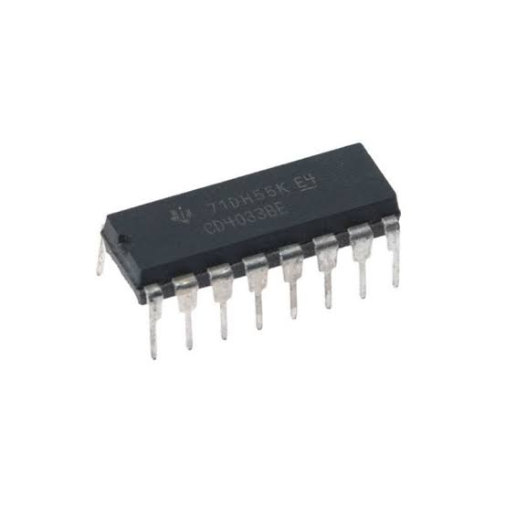
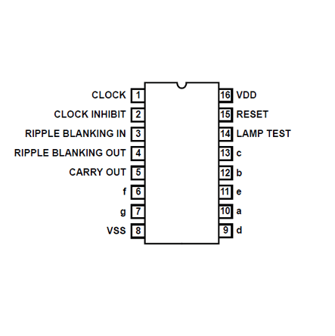
The IC 4033:-

Slide 4
Electrical characteristics:-
Supply voltage range: 3V to 18V
Input voltage range:
Clock input: 0V to VDD
Display enable input: 0V to VDD
Ripple-blanking input: 0V to VDD
Operating temperature range: -40°C to +85°C
Quiescent current: up to 100 nA at VDD = 18V and T = +25°C
Maximum clock frequency: 8MHz (typical) at VDD = 10V

Slide 5
Input capacitance:
Clock input: 10pF (typical)
Display enable input: 5pF (typical)
Ripple-blanking input: 5pF (typical)
Output drive capability:
Sink current: 5mA (minimum)
Source current: 0.4mA (minimum)
Propagation delay:
Clock input to any output: 45ns (typical)
Ripple-blanking input to any output: 45ns (typical)
Power dissipation:
Quiescent power: up to 1.8mW at VDD = 18V and T = +25°C
Maximum power dissipation: 500mW
ESD protection: 2000V (minimum)

Slide 6
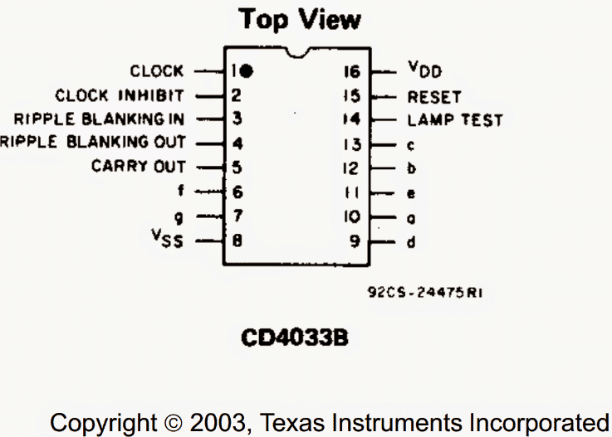
How IC 4033 Works
The IC 4033 is another Johnson decade counter/decoder IC specifically designed for working with 7 segment displays.
Basically it’s a clock or pulse counter IC which responds to positive pulses at its clock input and decodes it serially to produce a directly readable display of the count number through the connected 7 segment display module

Slide 7
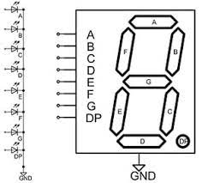
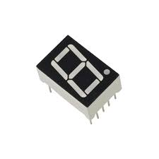
The 7 segment com cathod:-

Slide 8
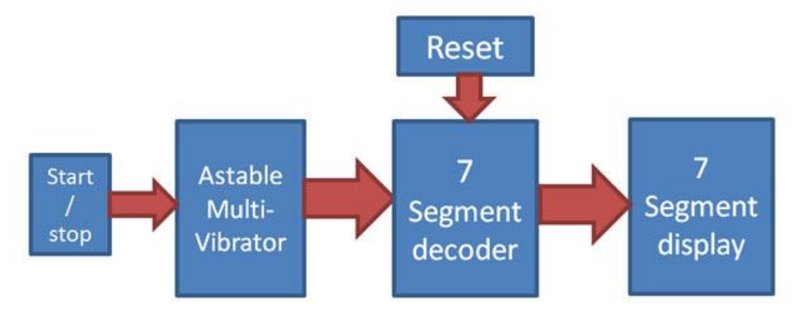

Slide 9
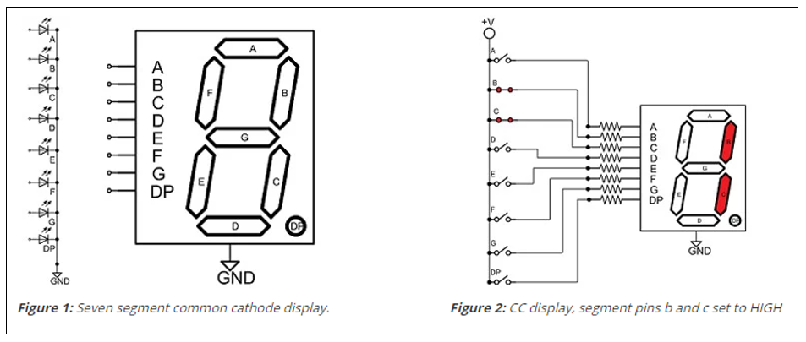

Slide 10
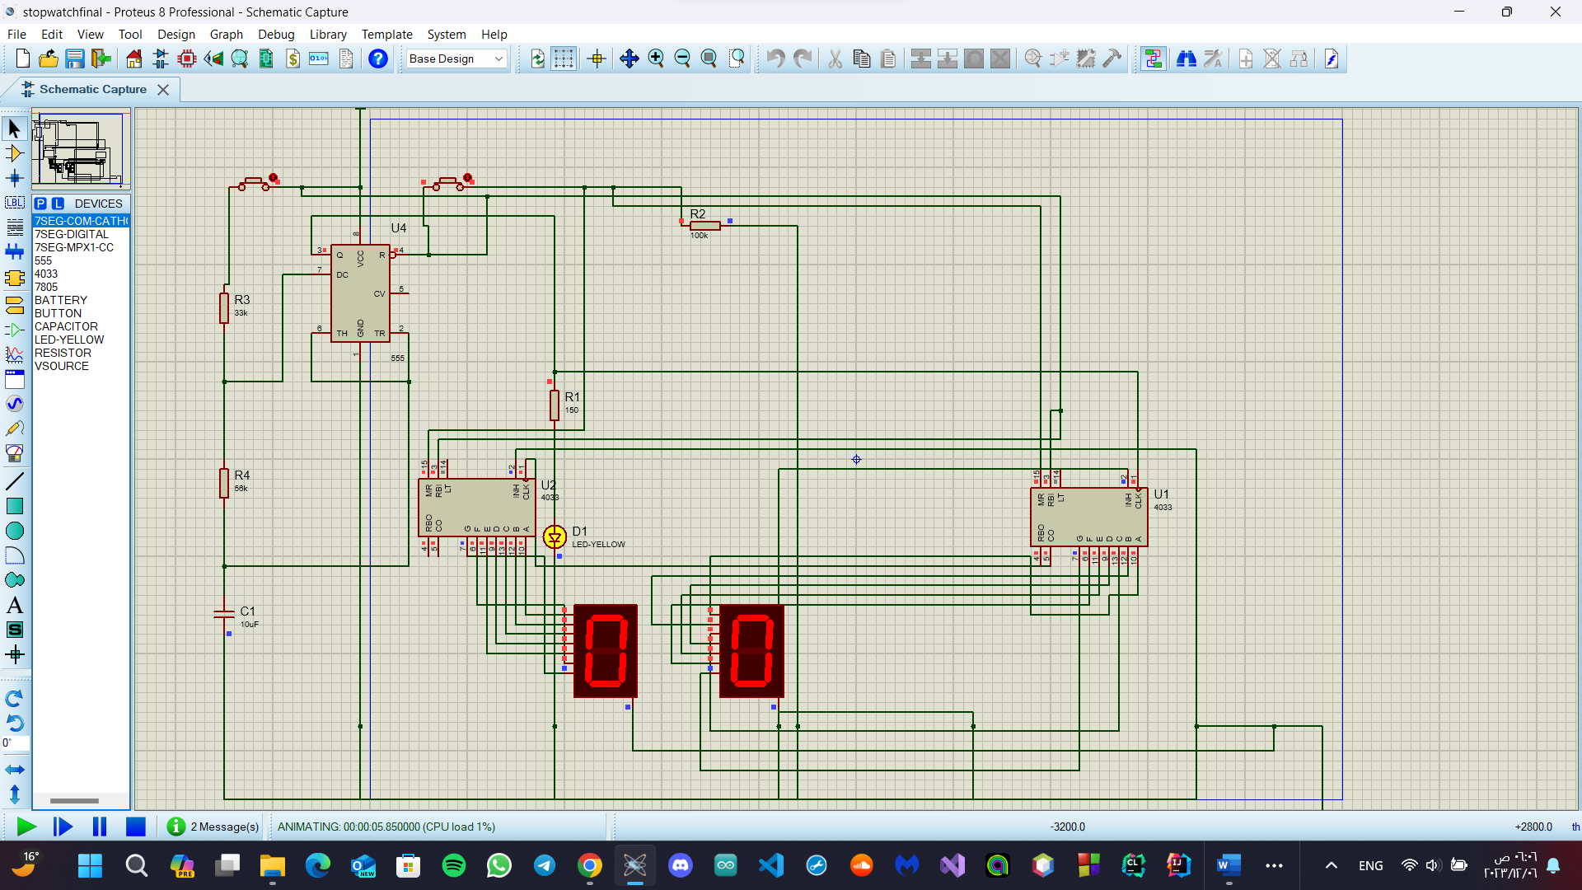
How the circuit works:-
1-When we press the start button, we see the screen start counting with a time delay of one second, and the pulse time is controlled by the values of the resistors and capacitors connected to the timer.
2-When we press the reset button, we see that the timer has zeroed

Slide 11
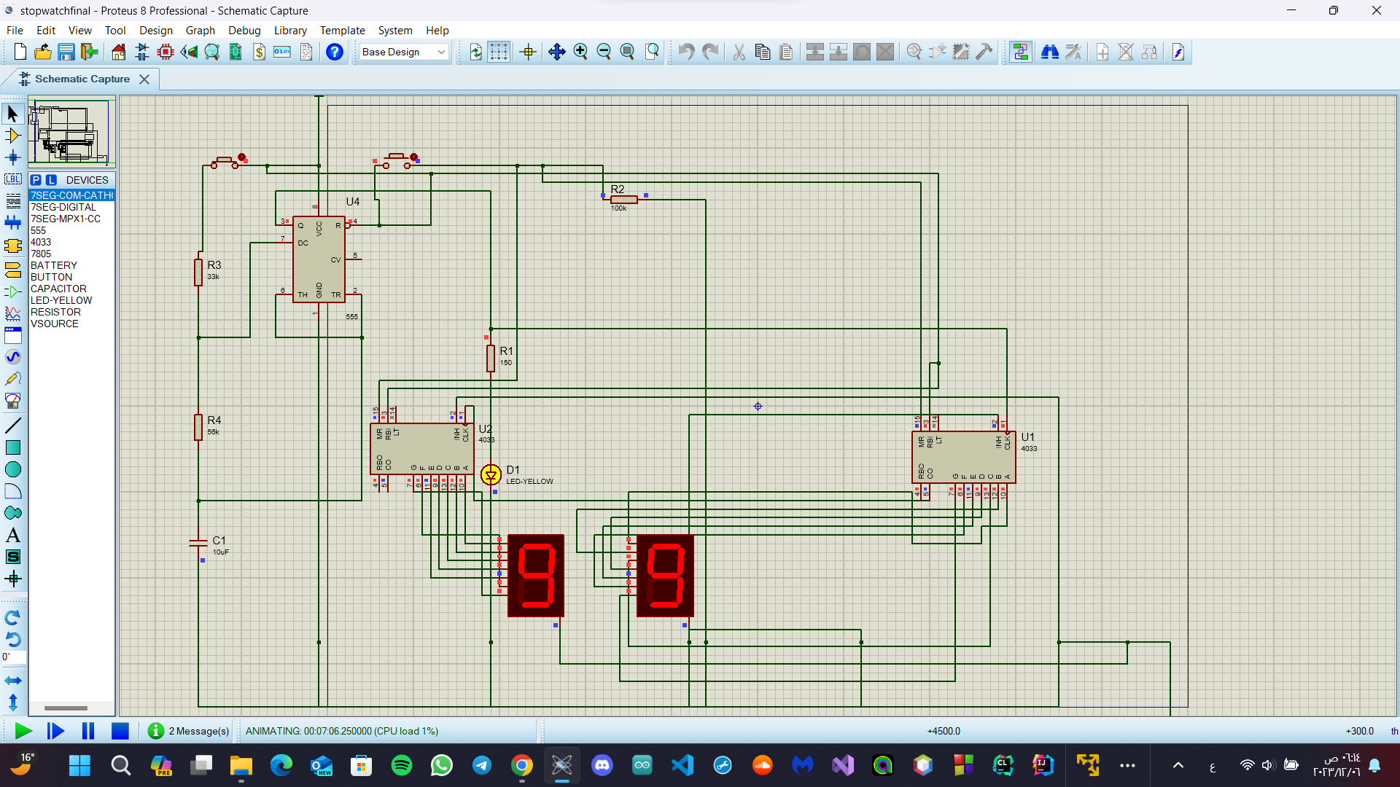
3-When we press the start button again, the counting starts from the beginning until it reaches the number ninety-nine, then it returns to zero again and starts counting again

Slide 12
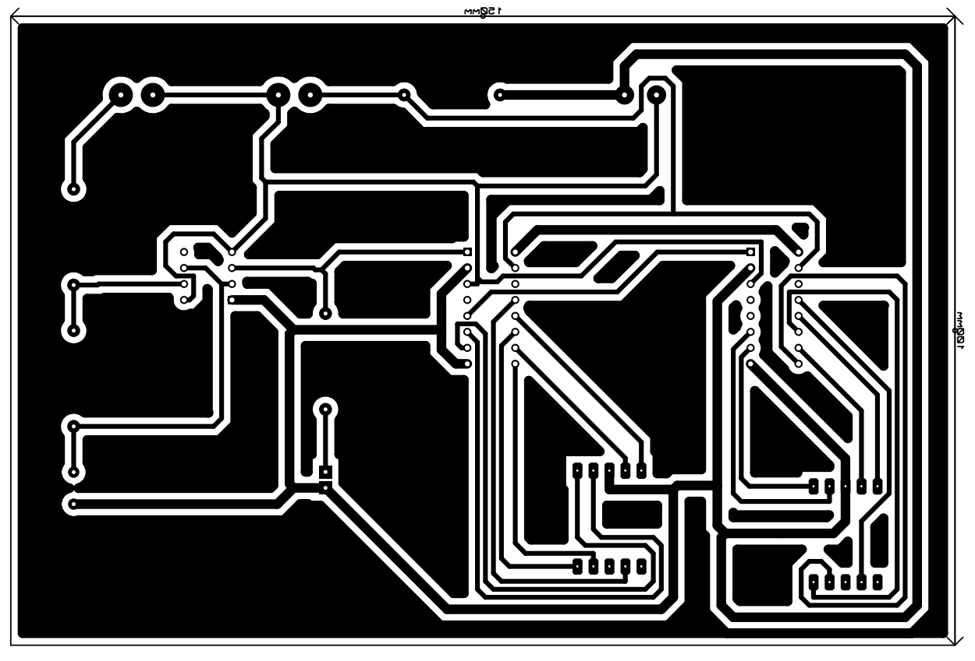
The PCP layout:-

Slide 13
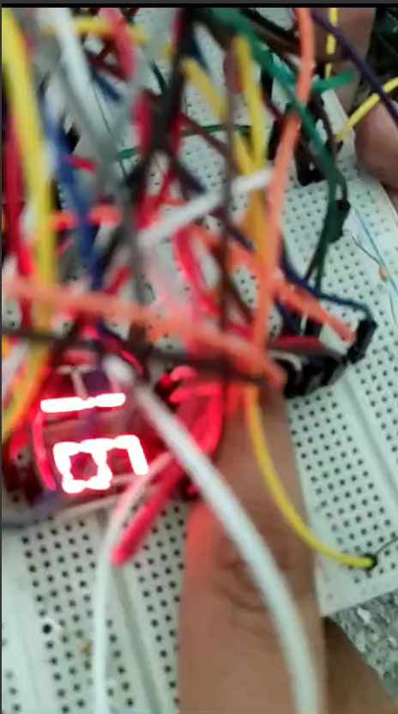
The project working on the test board:-

